Slide 1
Why we need Data Engineering?

Slide 2

Imagine this
You are an owner of a brand new racing team,
trying to qualify to compete in F1
You have recruited the best drivers and engineers
You bought the best parts recommended by your specialists in charge of the different parts of the race car
However,
The parts do not fit well together.
There is lack of proper communication within the team due to language barrier.
Do you think you can still win the race?
Notes:
Imagine that you are an owner of a brand new racing team, trying to qualify to compete in F1.
You are very confident that you will win the race because you invest heavily and recruited the best F1 driver out there together with a pool of very talented engineers, analysts and mechanics.
However, there are a few problems.
First, although you have bought the best parts that was recommended by each team in charge of the different parts of the race car, the parts do not fit well together.
Second, your crews are not able to properly communicate to one another because of language barrier.
Do you think you can still win the race?
If not, what do you think can be done?

Slide 3
Similarly, the company is also facing this issue
Because data collected by the different teams are not standardized and not accessible to one another (data silos), we are not able to unlock the full value of data

Slide 4
Problems that arises from Data Silos
Incurring unnecessary data storage costs due to duplicated data across the departments
Increases the risk of data security
Leaders are not able to make the best decisions because of blind spots from short-sighted data
Reduces productivity and creates a less collaborative environment

Slide 5
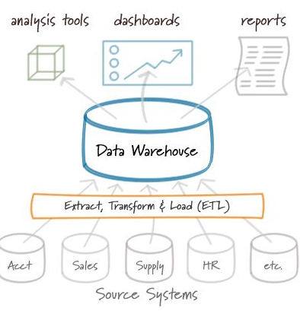
Solution?
We need to build a central repository (Data Warehouse) to store all department’s data in one place for easier maintenance and ensuring of data quality.

Slide 6
Benefits?
Reduce operating cost from saving up precious storage space and maintaining different department’s databases
Increase data security. Easier to secure a central repository than multiple databases
Achieve data integrity from standardization
Improves collaboration, productivity and achieve better decision making from unlocking the full value of data

Slide 7
Thank you

